Slide 1
11kW OBC CLLLC CV Reverse
Lim Shu Fan
13.5.2022

Slide 2
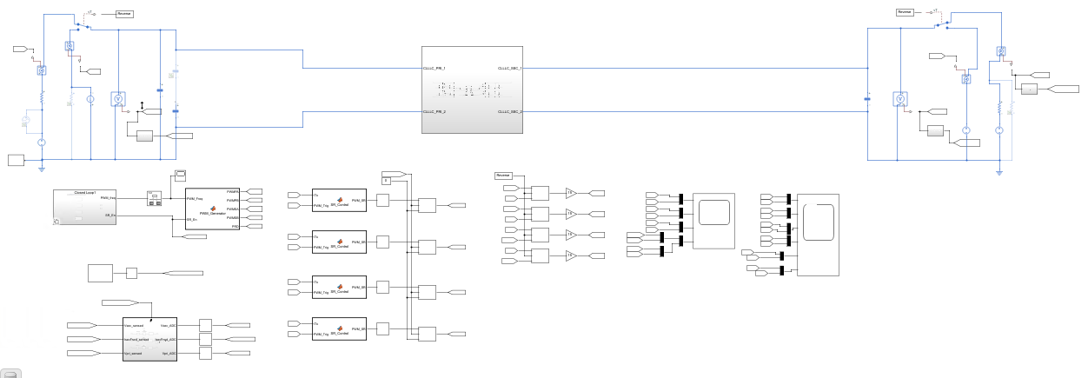

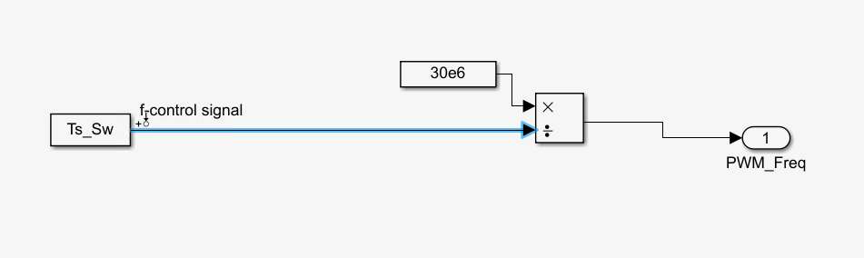
Getting the plant transfer function (Ts to Vpri for CV in reverse mode)
Output signal– Primary side voltage
Input perturbation – switching period

Slide 3
Steps to get Bode plots in MATLAB
Go to Apps -> linearization manager -> select the switching period as input perturbation and output current as output signal
Go to Apps -> Model linearizer -> estimation tab
In Estimation tab -> Model initial conditions -> take simulation snapshot -> put in simulation steady state time at 0.012s
In Estimation tab -> input signal -> select fixed sample time sinestream
Sample time -> 1e-7 (if 50e-6, can only measure frequency range up to 10kHz)
Frequency unit -> Hz
Add new frequencies to the signals -> 10Hz to 100kHz, number of frequencies 30
Select all the frequencies and change amplitude to 20/10 (because +/-2kHz around 58kHz/82kHz)
Select Bode and simulation will start

Slide 4
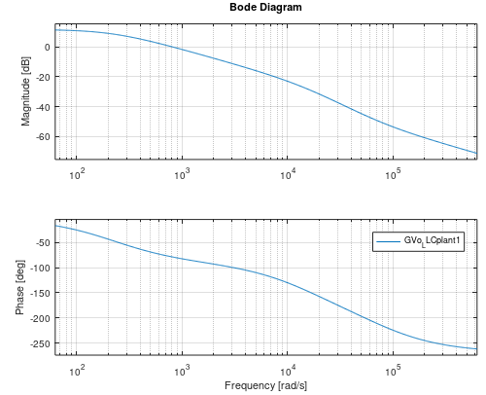
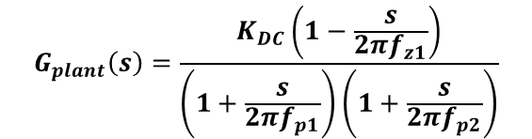
The plant transfer function (open loop sweep) 250V output 8.35kW
$$G_{plant}\left(s\right)=\frac{K_{DC}\left(1−\frac{s}{2πf_{z1}}\right)}{\left(1+\frac{s}{2πf_{p1}}\right)\left(1+\frac{s}{2πf_{p2}}\right)}$$
GDC=11.6841, KDC=10^(GDC/20), fz1= 12kHz, fp1=35Hz, fp2=2.4kHz
Operating point
Vin = 250V
Vout = 800V
Iout = 10.31A
Fsw = 58kHz
NOTE: Simulation cannot run at 250V 9.25kW!

Slide 5
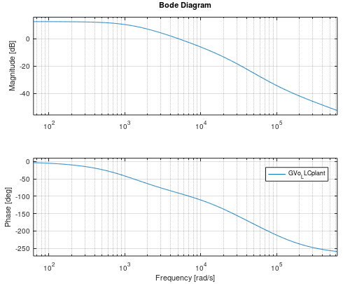
The plant transfer function (open loop sweep) 470V output 11kW
$$G_{plant}\left(s\right)=\frac{K_{DC}\left(1−\frac{s}{2πf_{z1}}\right)}{\left(1+\frac{s}{2πf_{p1}}\right)\left(1+\frac{s}{2πf_{p2}}\right)}$$
GDC=12.7054, KDC=10^(GDC/20), fz1= 15kHz, fp1=200Hz, fp2=4kHz
Operating point
Vin = 470V
Vout = 800V
Iout = 13.75A
Fsw = 82kHz

Slide 6
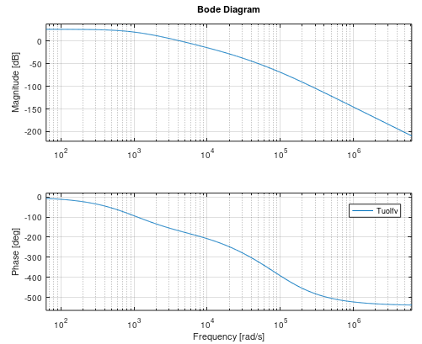
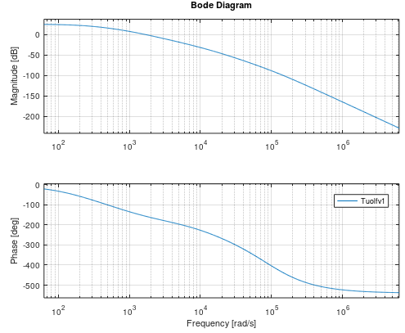
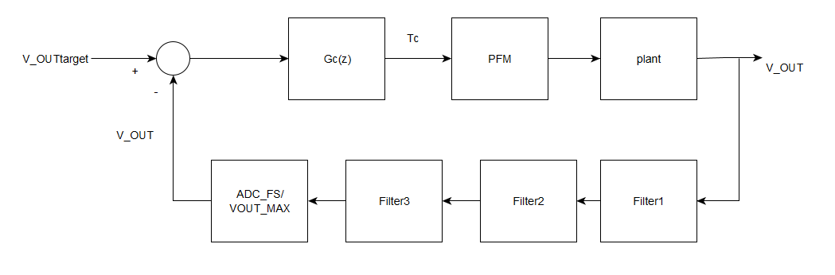
The uncompensated open loop gain at 470V and 250V respectively
Uncompensated loop gain 470V 11kW
Uncompensated loop gain 250V 8.35kW

Slide 7
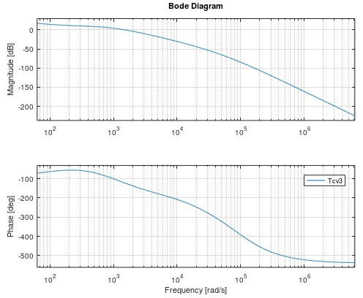
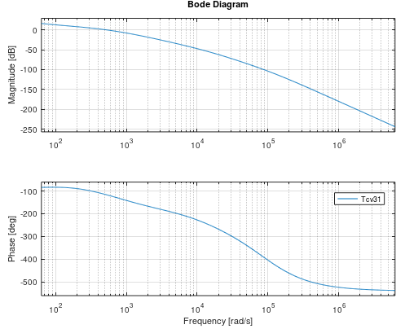


PI compensator design (50us)
Compensated loop gain 470V 11kW
Compensated loop gain 250V 8.35kW
Design Output
Fc =255Hz
PM =56deg
GM=-19dB
Design Output
Fc =81Hz
PM =64deg
GM=-25dB
Design parameters
FzL =20Hz
Gfc=15.38dB
KL=1/(10^(Gfc/20))
$$G_{c}\left(s\right)=K_{L}\left(1+\frac{2πf_{zL}}{s}\right)$$
Tustin

Slide 8
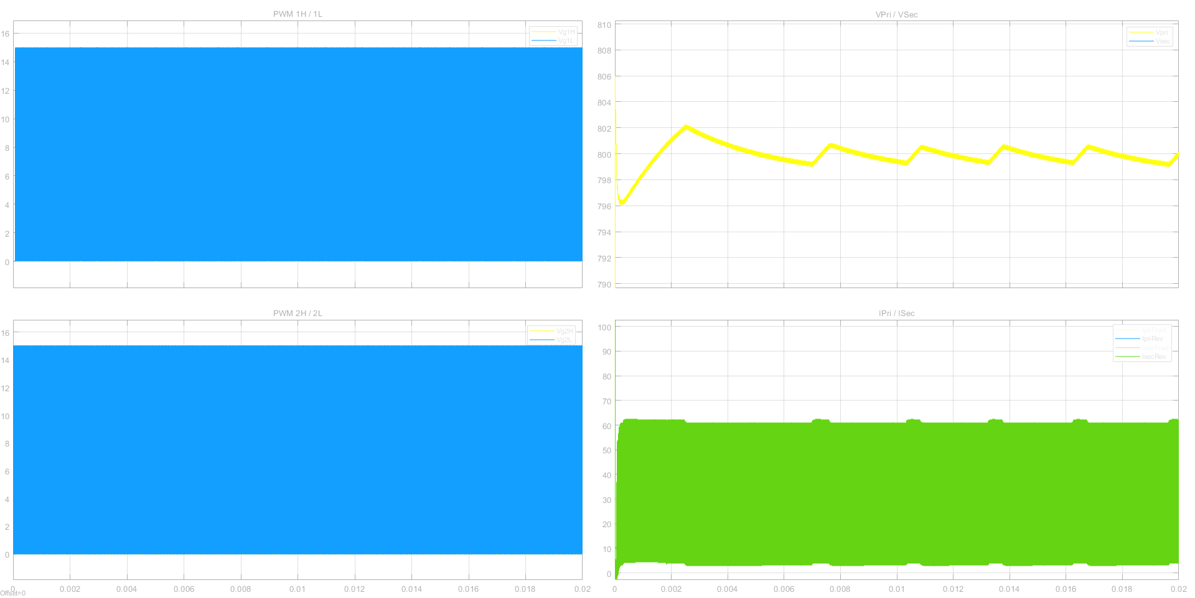
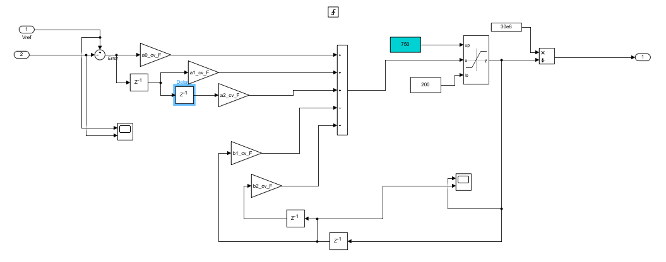
At 250V input, 800V output and 8.35kW,
Output ripple specs is +/-2% of output voltage.
At 800V, output ripple should be < +/-16V.
Init value of controller is 513

Slide 9
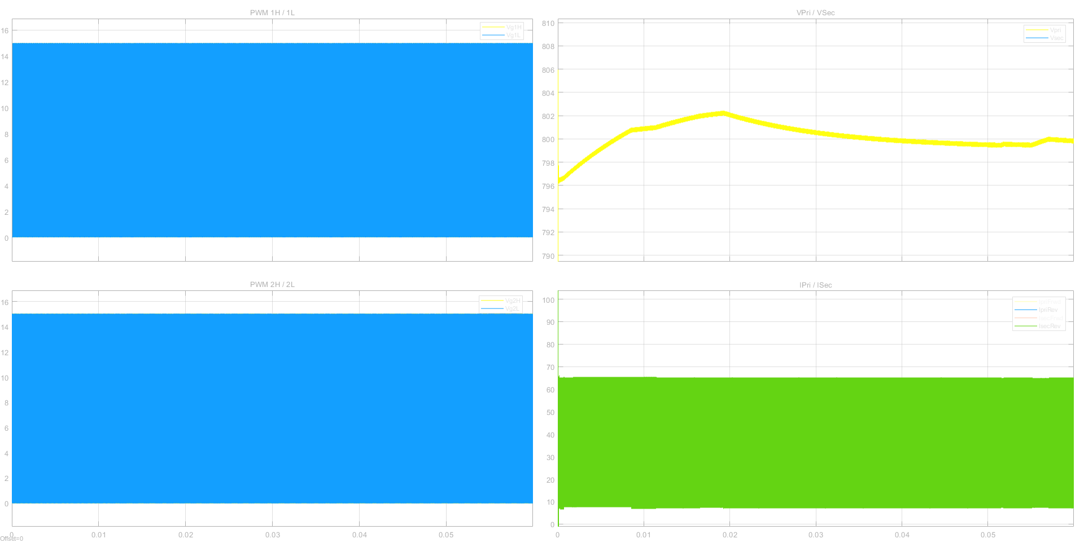
At 250V input, 800V output and 8.9kW,
Init value of controller is 531
NOTE: Simulation cannot run at 250V >9kW!

Slide 10
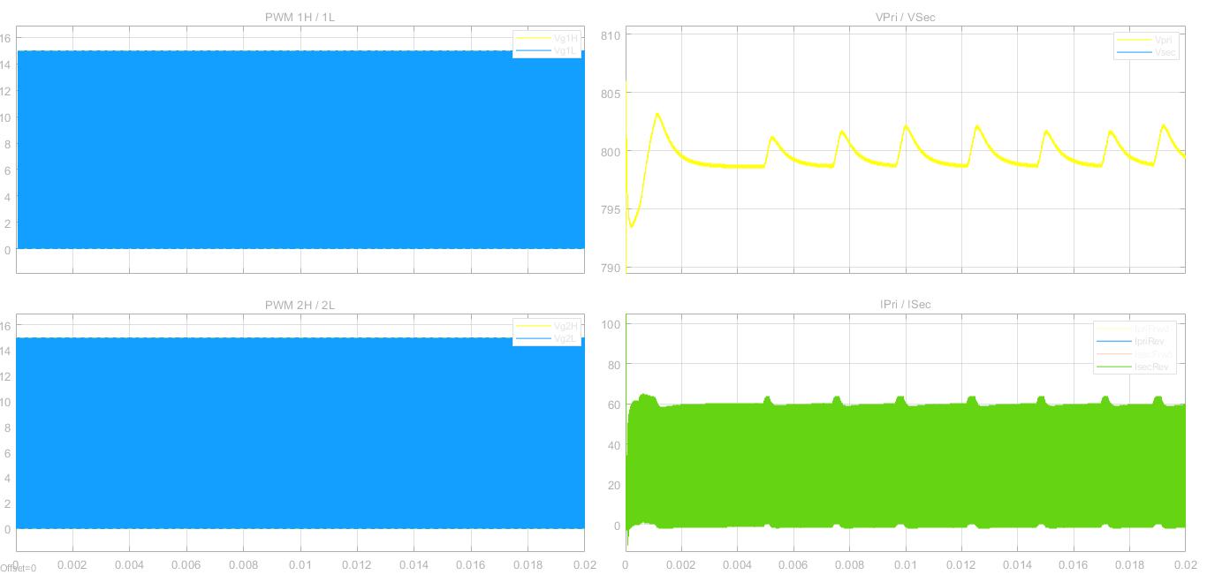
At 350V input, 800V output and 11kW,
Init value of controller is 437

Slide 11
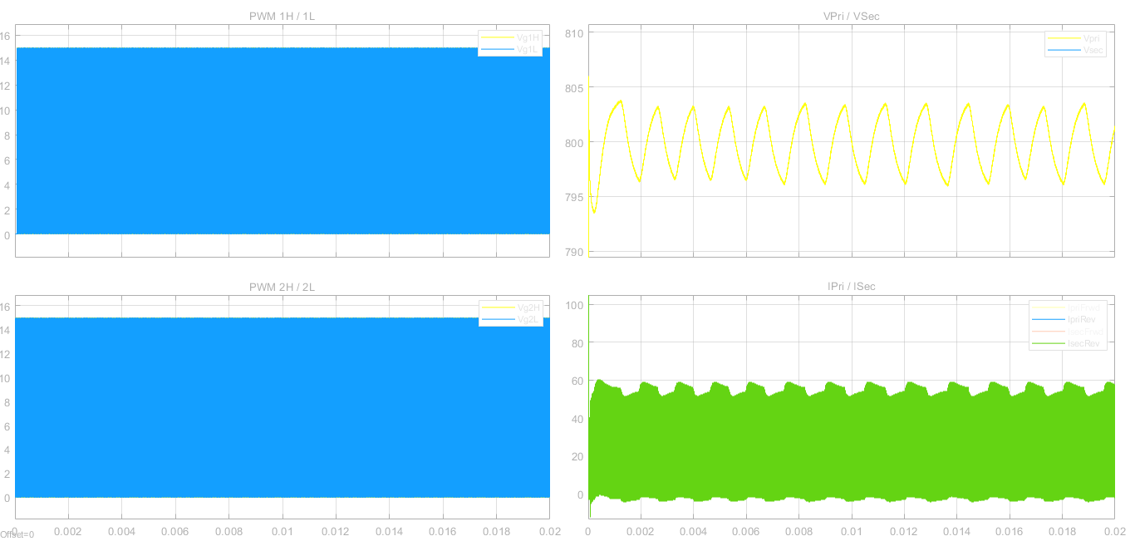
At 400V input, 800V output and 11kW,
Init value of controller is 399

Slide 12

At 470V input, 800V output and 11kW,
Init value of controller is 363

Slide 13
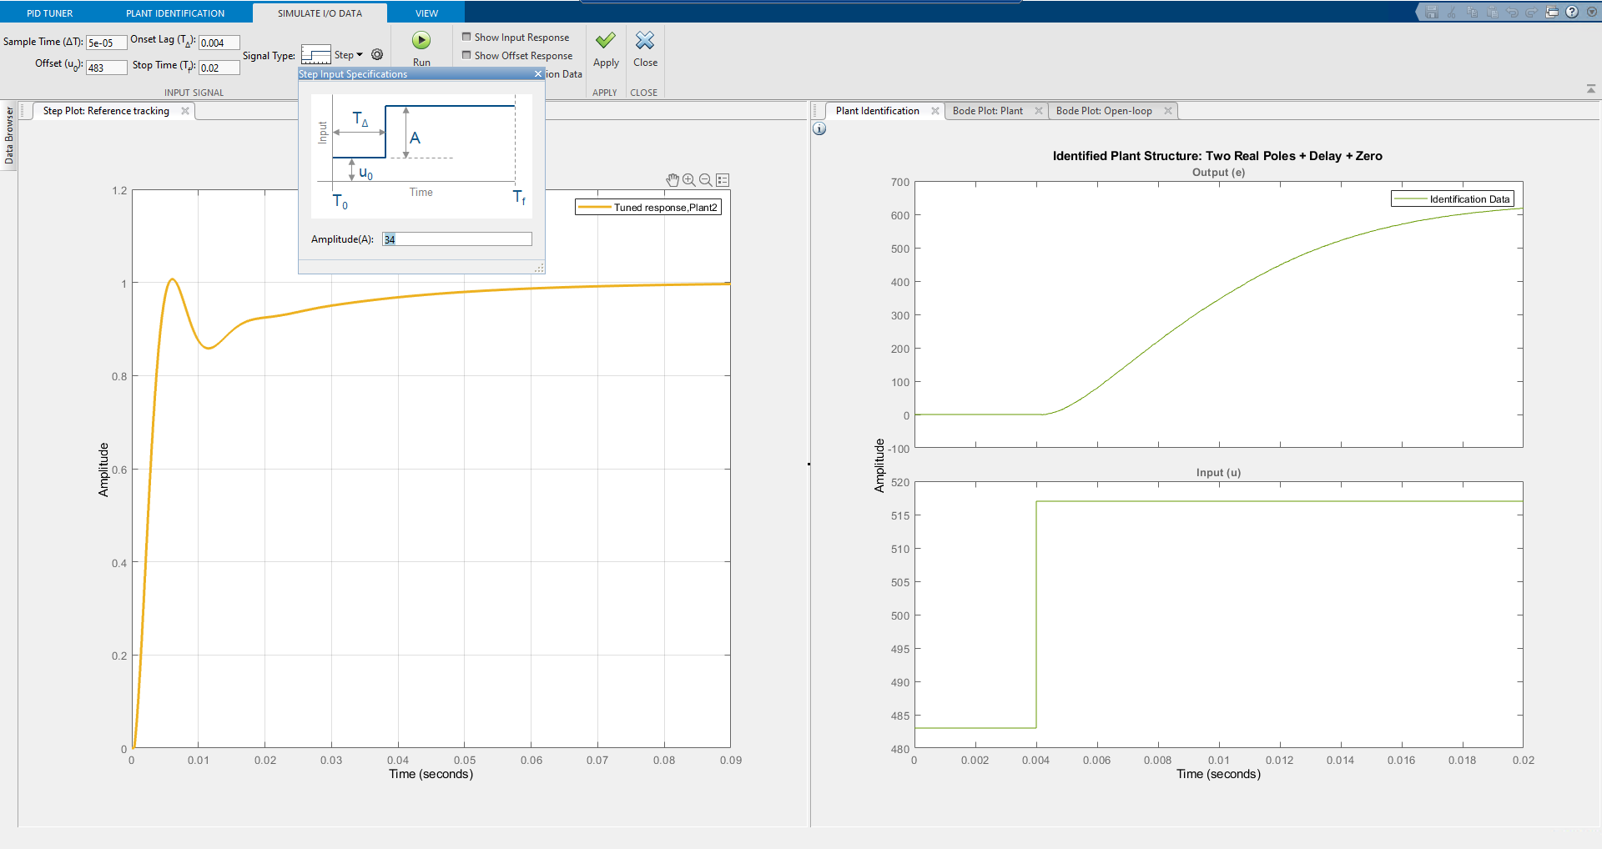
Control design using PID tuner – Settings for simulation run at 250V 8.35kW

Slide 14
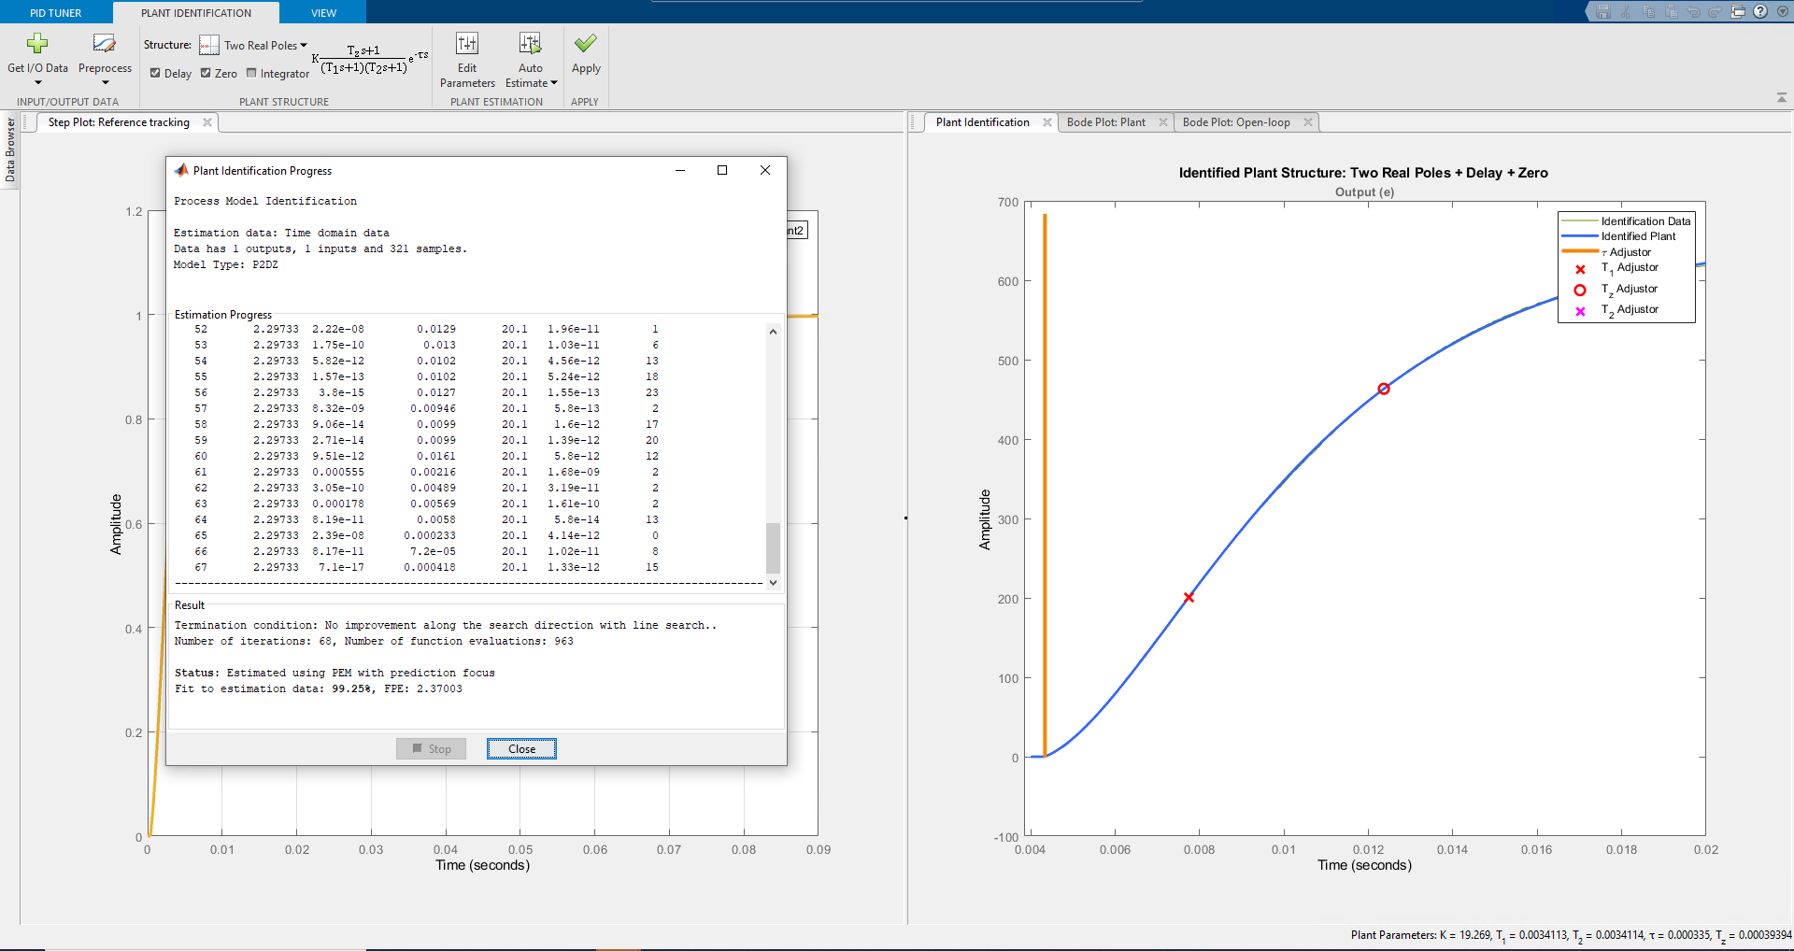
Control design using PID tuner – Plant identification

Slide 15
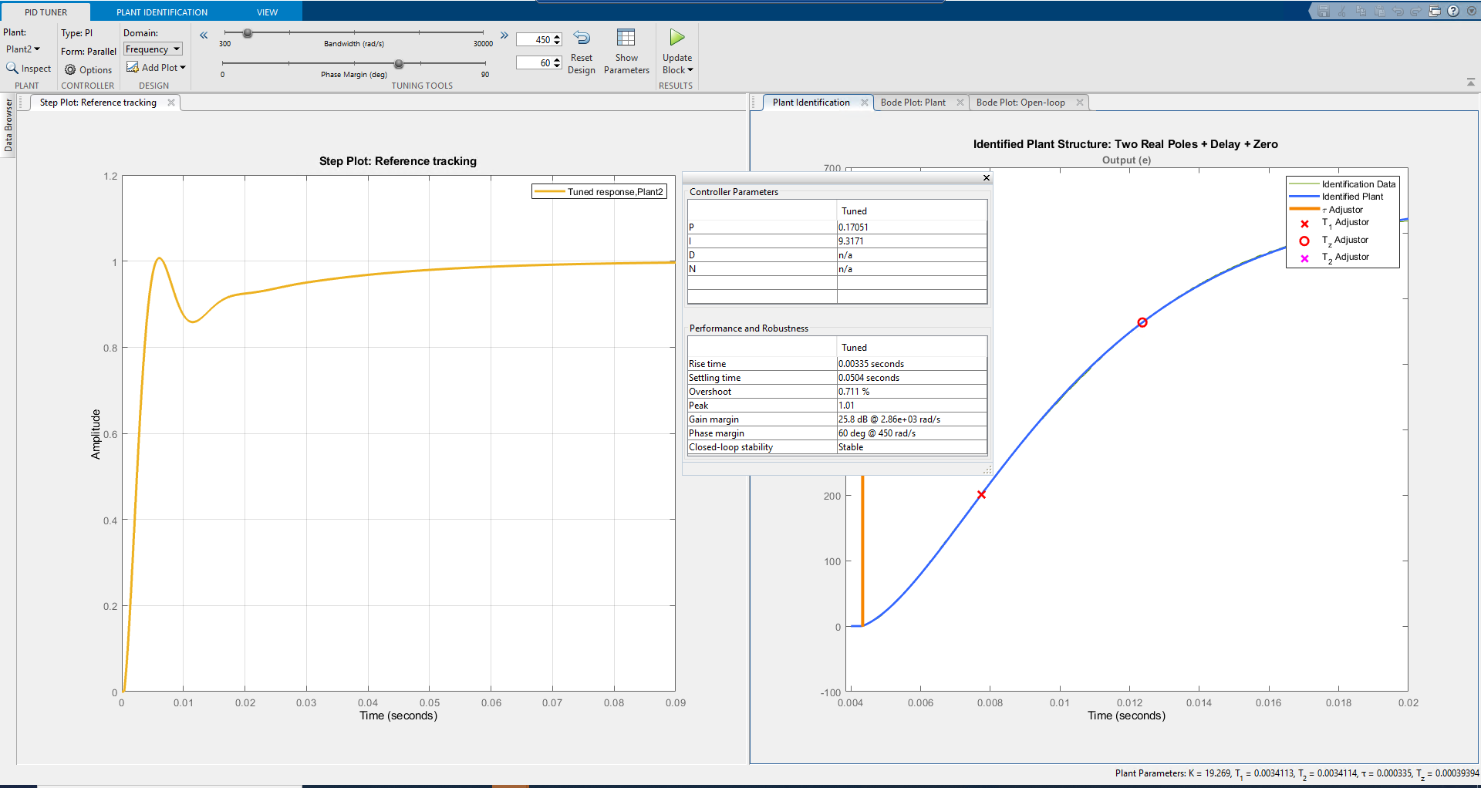
Control design using PID tuner – PID tuning

Slide 16
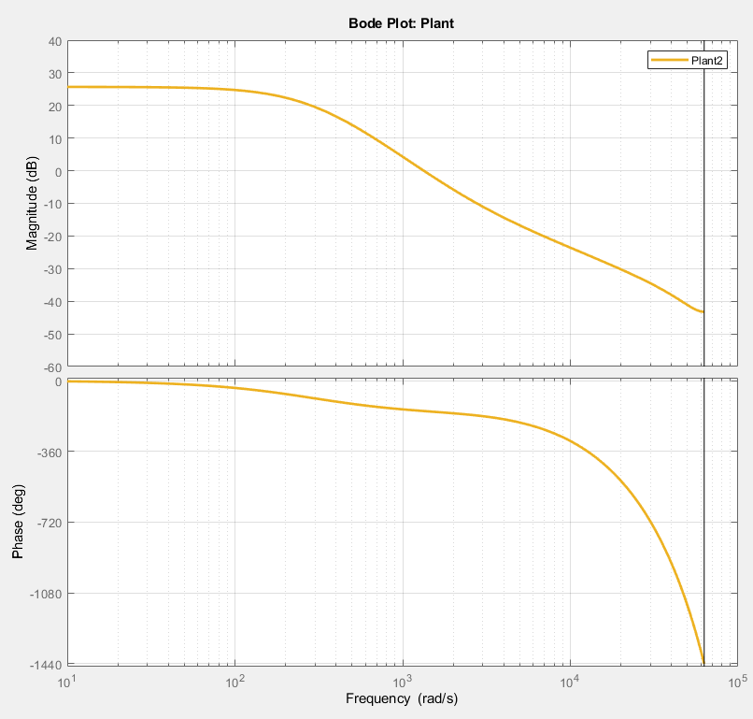
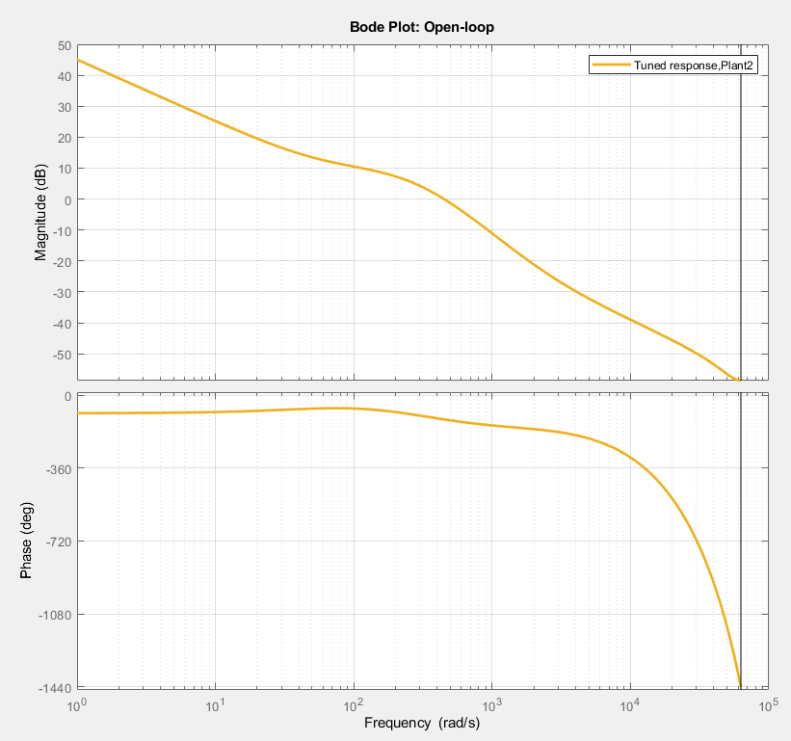
Bode plot of plant and Open loop bode plot

Slide 17
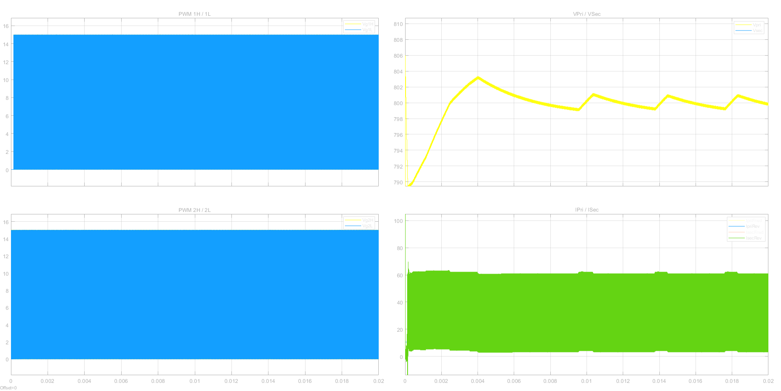
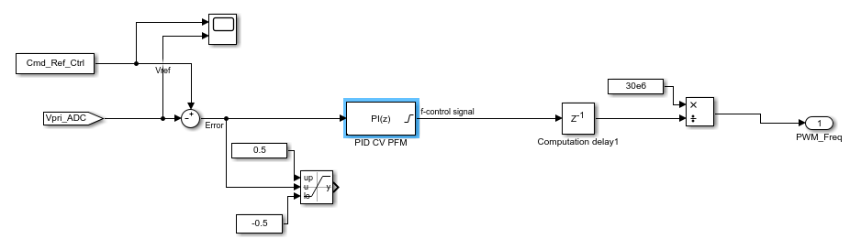
At 250V input, 800V output and 8.35kW,
Init value of controller is 511

Slide 18
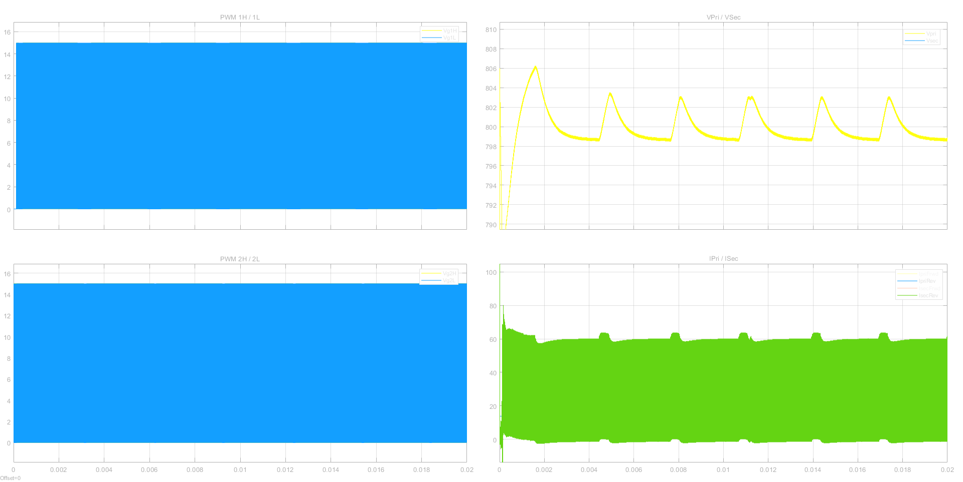
At 350V input, 800V output and 11kW,
Init value of controller is 436

Slide 19
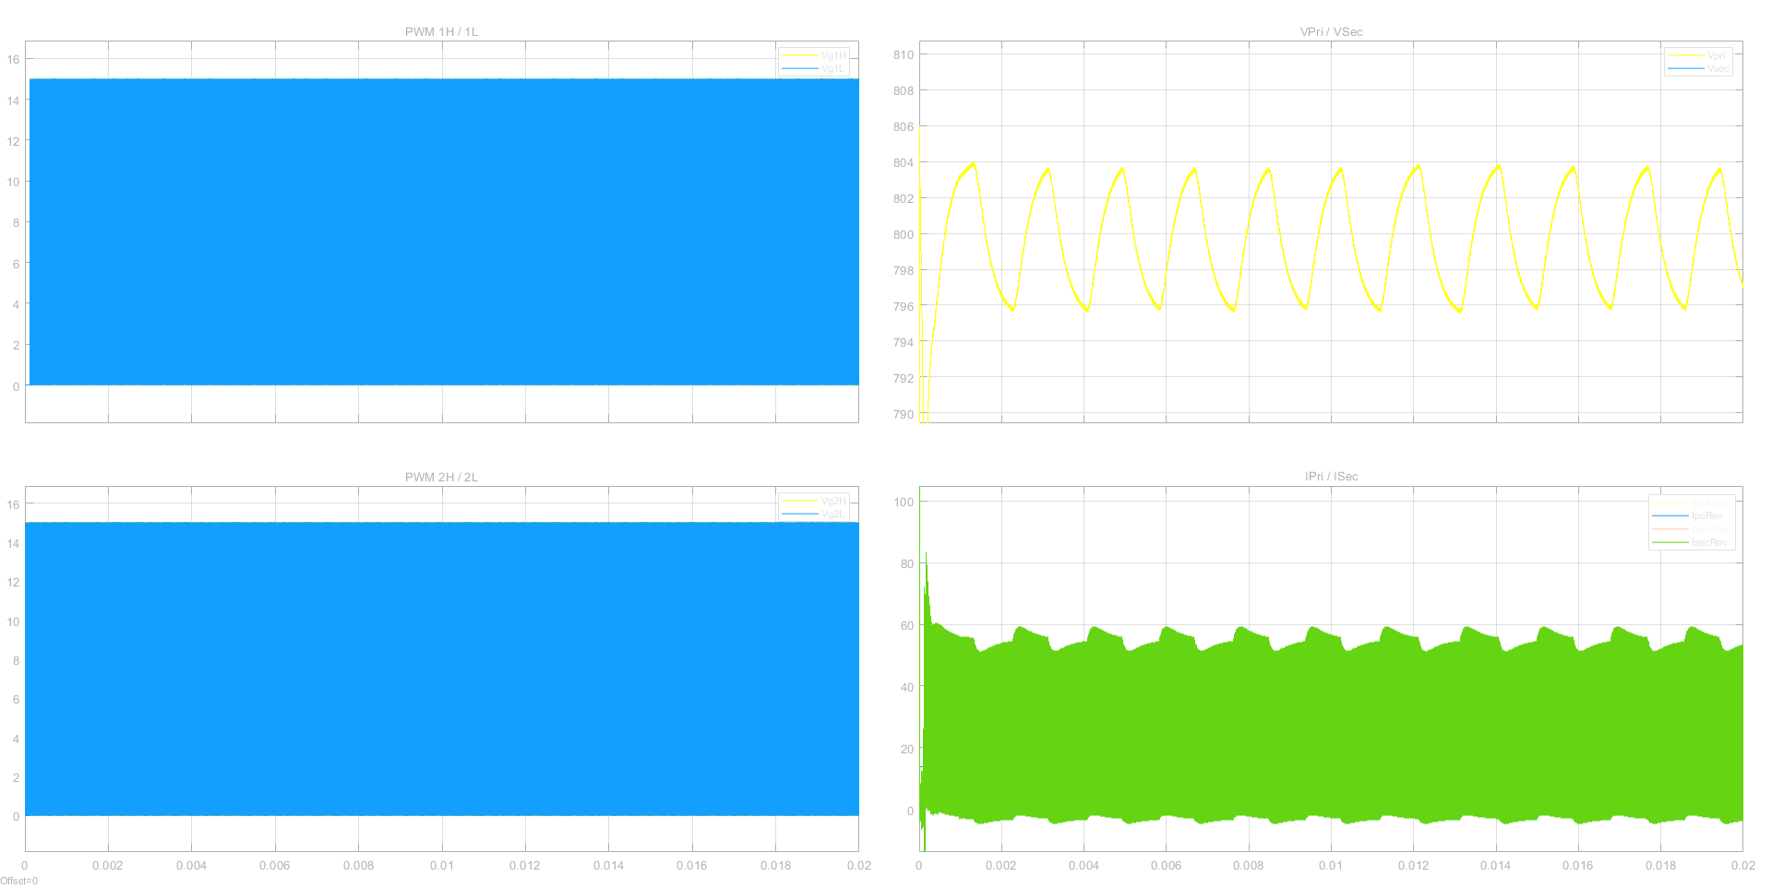
At 400V input, 800V output and 11kW,
Init value of controller is 397

Slide 20
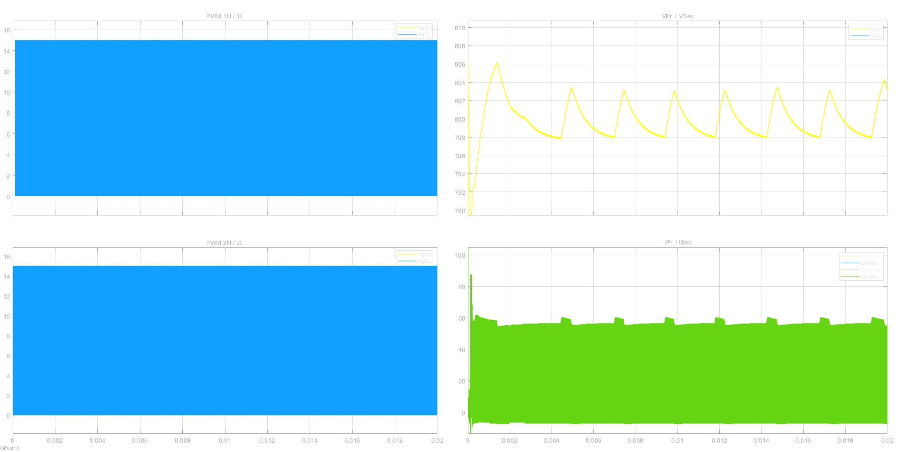
At 800V input, 470V output and 11kW,
Init value of controller is 361

